Slide 1
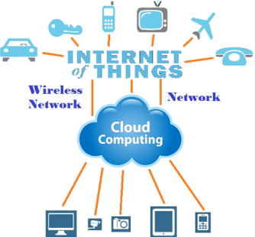
IOT AND CLOUD COMPUTING
By,
Ass. Prof. Kunal D Gaikwad
Pursuing PHD (IOT and Machine Learning)
M.E(Computer Networks)
B.E(Computer Science & Engineering)
Diploma(Computer Engineering)
Ass. Prof. Kunal D Gaikwad
CSE Department, CMRIT

Slide 2
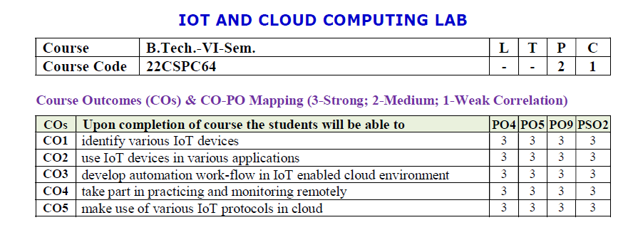
Ass. Prof. Kunal D Gaikwad
CSE Department, CMRIT

Slide 3
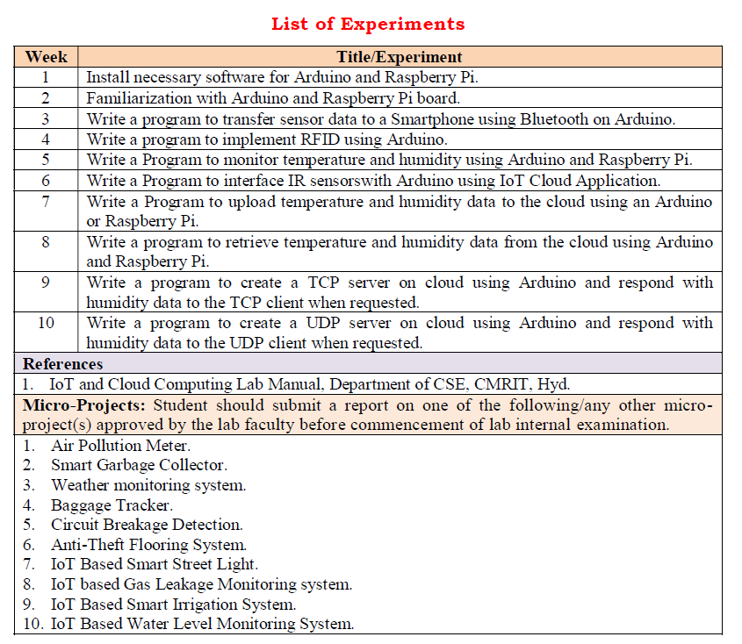
Ass. Prof. Kunal D Gaikwad
CSE Department, CMRIT

Slide 4
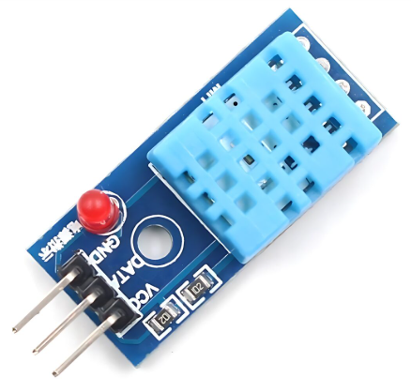
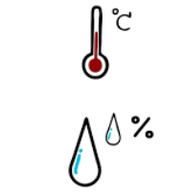
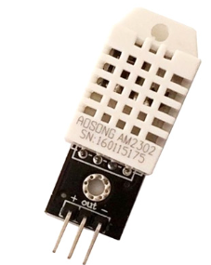
The DHT11 is a digital temperature and humidity sensor that provides calibrated output via a single-wire communication protocol. It is commonly used in weather monitoring systems, home automation, and IoT applications.
1. Weather Monitoring Systems
🌤️ Used in DIY and professional weather stations to measure temperature and humidity levels.
2. Home Automation & Smart Homes
🏡 Integrated into IoT-based smart home systems for automatic climate control, triggering fans, air purifiers, or dehumidifiers.
3. Greenhouse Monitoring
🌱 Helps maintain optimal temperature and humidity levels for plant growth in agricultural environments.
4. Industrial Environmental Monitoring
🏭 Used in factories and warehouses to monitor environmental conditions that affect machinery and stored goods.
5. HVAC (Heating, Ventilation, and Air Conditioning) Systems
❄️ Helps in climate control systems by providing real-time temperature and humidity data for automated adjustments.
DHT11 Temperature and Humidity Sensor
DHT22 Temperature and Humidity Sensor
Ass. Prof. Kunal D Gaikwad
CSE Department, CMRIT

Slide 5
Specifications:
Temperature Range: 0°C to 50°C (±2°C accuracy)
Humidity Range: 20% to 90% RH (±5% accuracy)
Operating Voltage: 3.3V - 5V
Output Signal: Digital (single-wire)
Sampling Rate: 1 Hz (one reading per second)
Response Time: ~2 seconds
Dimensions: 15mm x 12mm x 5mm
Pinout:
VCC - Power supply (3.3V or 5V)
Data - Digital output (connect to a pull-up resistor, typically 4.7kΩ)
GND - Ground
DHT11 Temperature and Humidity Sensor
Ass. Prof. Kunal D Gaikwad
CSE Department, CMRIT

Slide 6
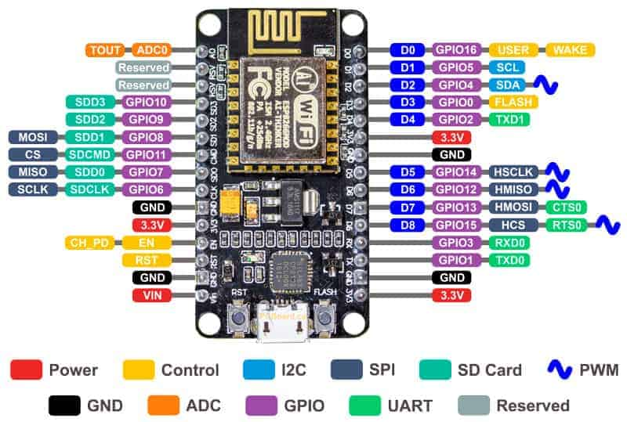
Ass. Prof. Kunal D Gaikwad
CSE Department, CMRIT

Slide 7


Slide 8
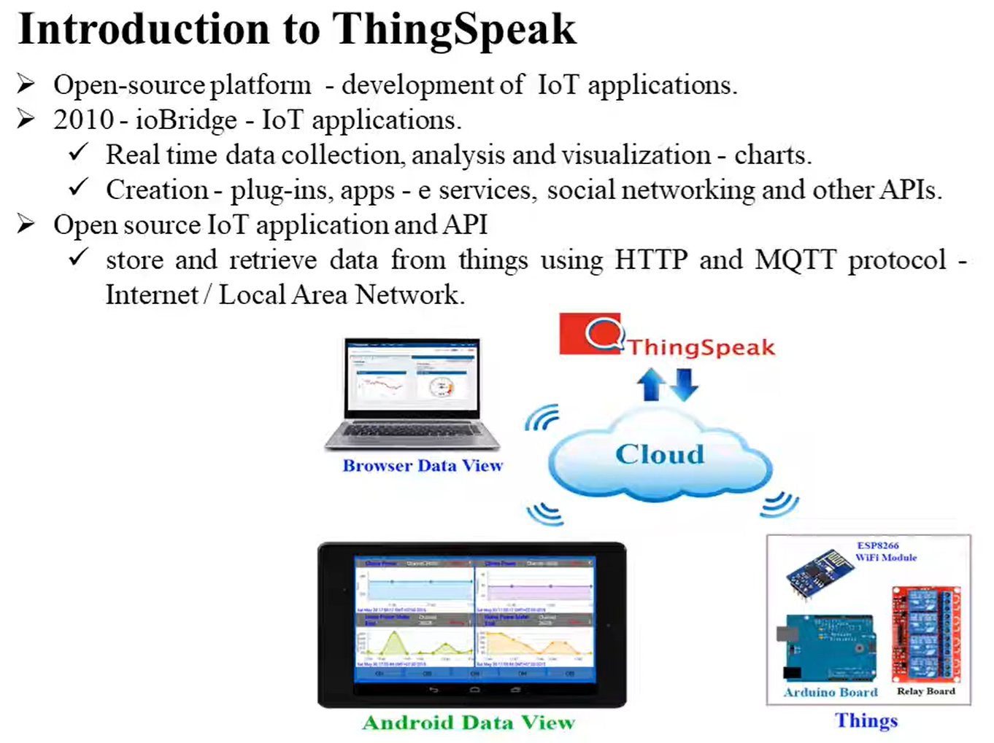
Ass. Prof. Kunal D Gaikwad
CSE Department, CMRIT

Slide 9
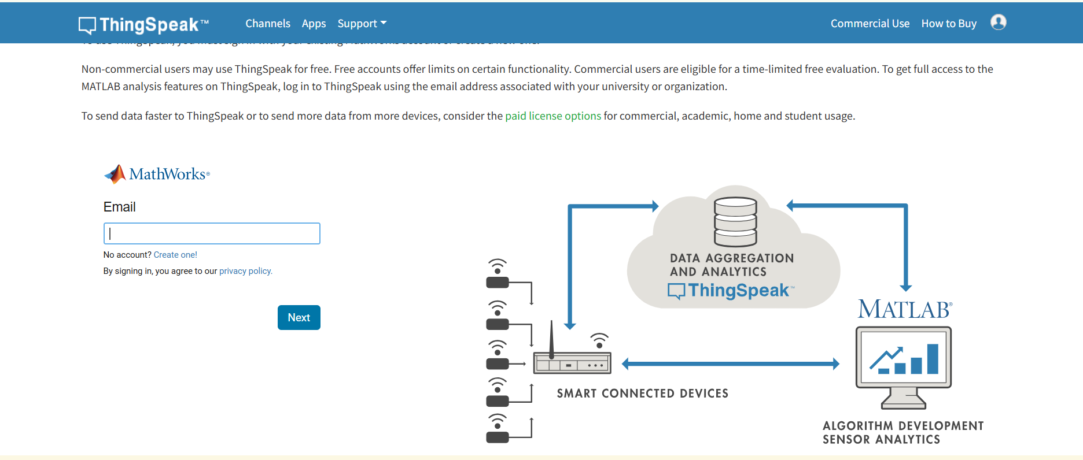
Ass. Prof. Kunal D Gaikwad
CSE Department, CMRIT

Slide 10
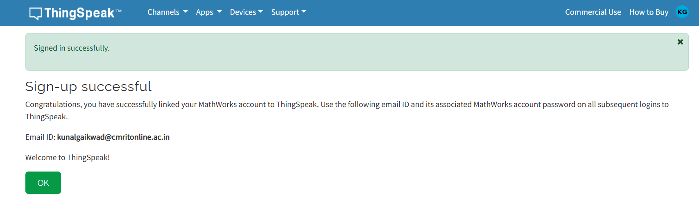
Ass. Prof. Kunal D Gaikwad
CSE Department, CMRIT

Slide 11
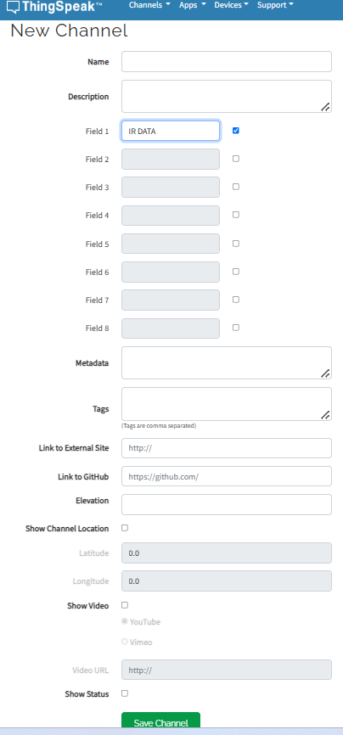

Temperature
Humidity
Ass. Prof. Kunal D Gaikwad
CSE Department, CMRIT

Slide 12
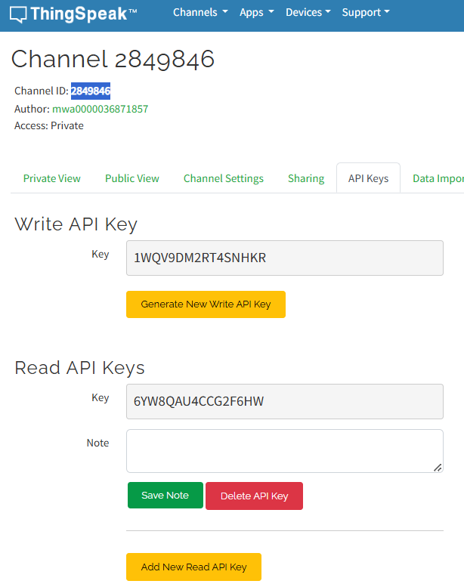
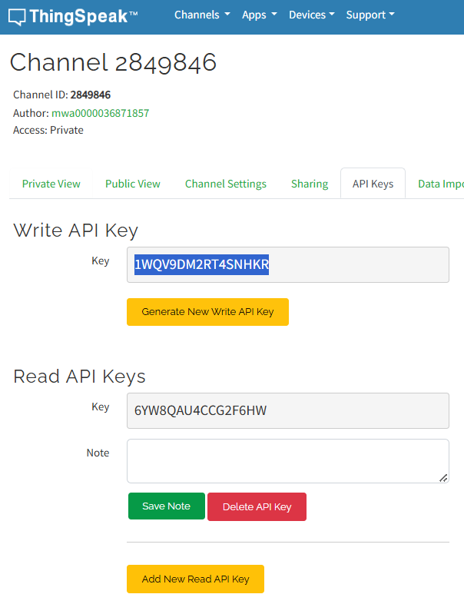
Ass. Prof. Kunal D Gaikwad
CSE Department, CMRIT

Slide 13
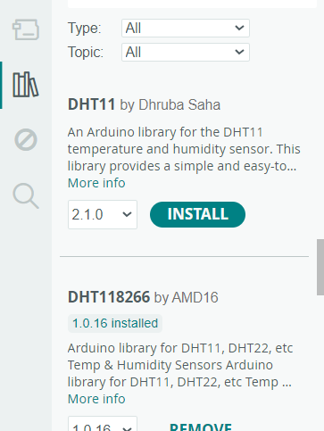
Ass. Prof. Kunal D Gaikwad
CSE Department, CMRIT

Slide 14
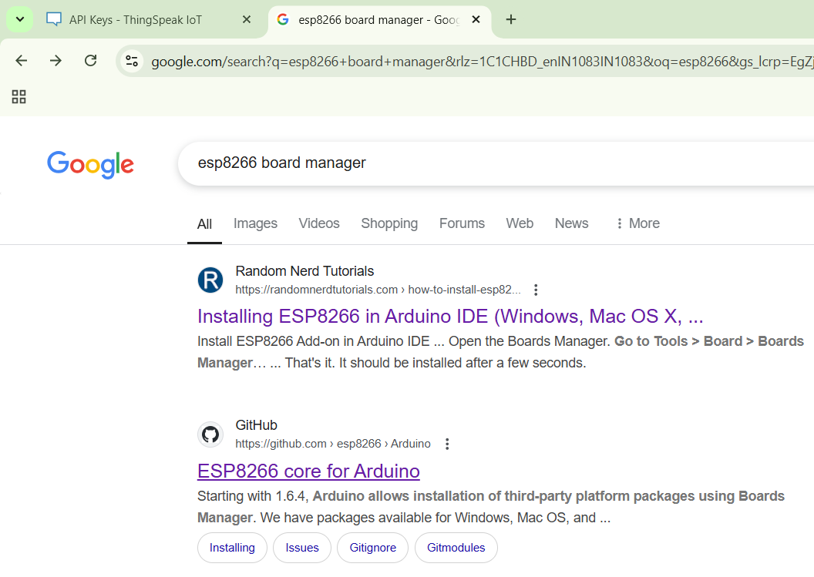
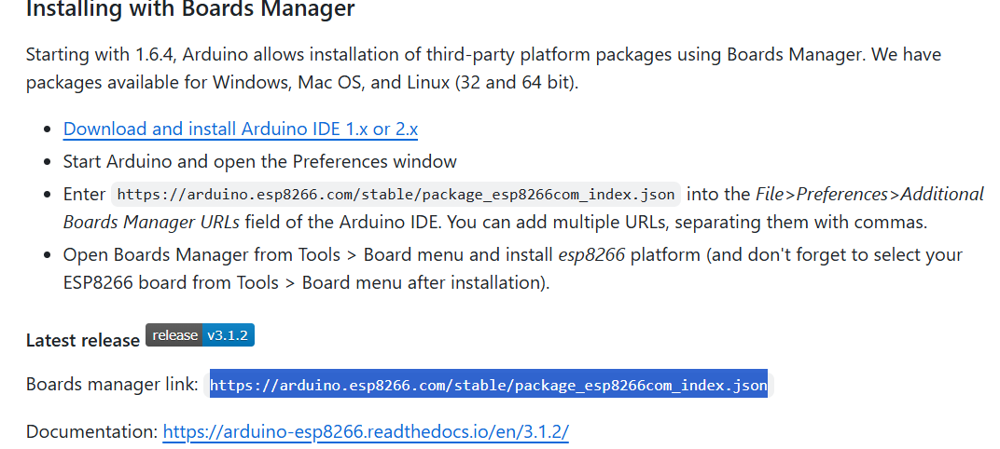
Ass. Prof. Kunal D Gaikwad
CSE Department, CMRIT

Slide 15
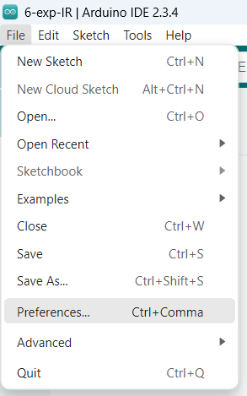
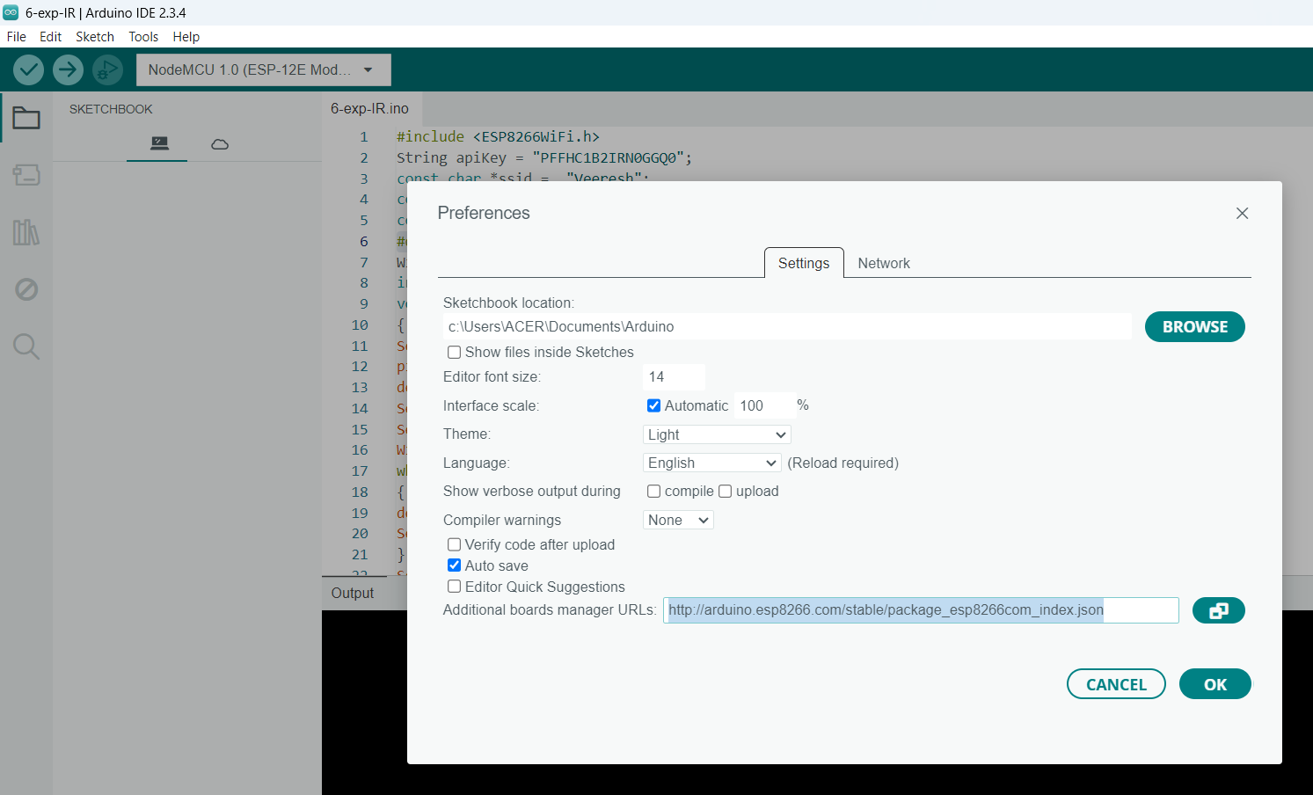
Ass. Prof. Kunal D Gaikwad
CSE Department, CMRIT

Slide 16
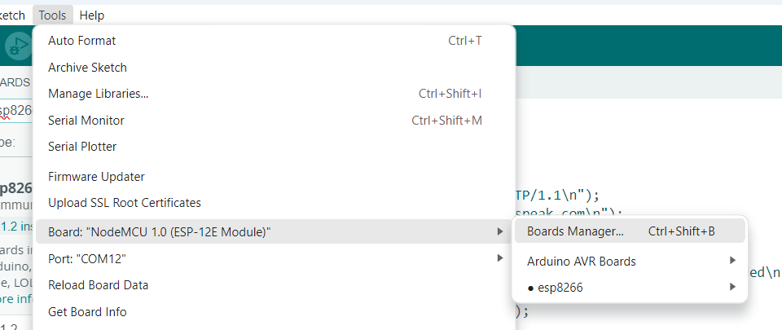
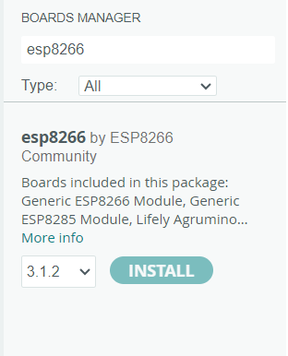
Ass. Prof. Kunal D Gaikwad
CSE Department, CMRIT

Slide 17
Ass. Prof. Kunal D Gaikwad
CSE Department, CMRIT

Slide 18
#include <DHT.h>
#include <ESP8266WiFi.h>
String apiKey = "UYK6QJGVZPSG5LF2"; // READ API key TS
const char *ssid = “kunal"; // Wifi Hotspot Name
const char *pass = “kunal123"; // Password
const char* server = "api.thingspeak.com";
#define DHTPIN D4
DHT dht(DHTPIN, DHT11);
WiFiClient client;
void setup()
{
Serial.begin(115200);
delay(1000);
dht.begin();
Serial.println("Connecting to ");
Serial.println(ssid);
WiFi.begin(ssid, pass);
while (WiFi.status() != WL_CONNECTED)
{
delay(500);
Serial.print(".");
}
Serial.println("");
Serial.println("WiFi connected");
}
void loop()
{
float h = dht.readHumidity();
float t = dht.readTemperature();
if (isnan(h) || isnan(t))
{
Serial.println("Failed to read from DHT sensor!");
return;
}
if (client.connect(server,80)) // "184.106.153.149" or api.thingspeak.com
{
String postStr = apiKey;
postStr +="&field1=";
postStr += String(h);
postStr +="&field2=";
postStr += String(t);
postStr += "\r\n\r\n";
client.print("X-THINGSPEAKAPIKEY: "+apiKey+"\n");
client.print("Content-Length: ");
client.print(postStr.length());
client.print("\n\n");
client.print(postStr);
Serial.print("Temperature: ");
Serial.print(t);
Serial.print(" degrees Celcius, Humidity: ");
Serial.print(h);
Serial.println("%. Send to Thingspeak.");
}
client.stop();
Serial.println("Waiting...");
delay(1000);
}
Ass. Prof. Kunal D Gaikwad
CSE Department, CMRIT

Slide 19
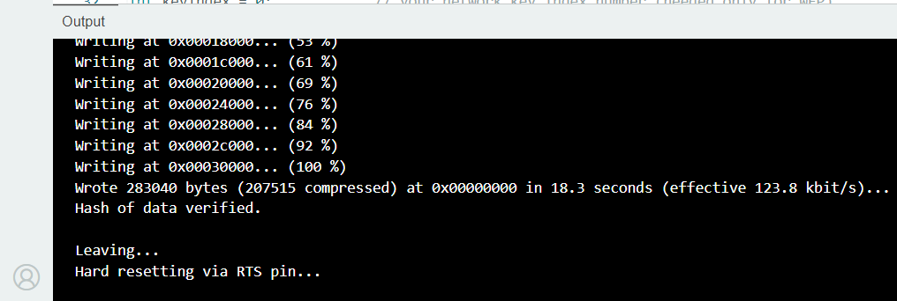
Ass. Prof. Kunal D Gaikwad
CSE Department, CMRIT

Slide 20
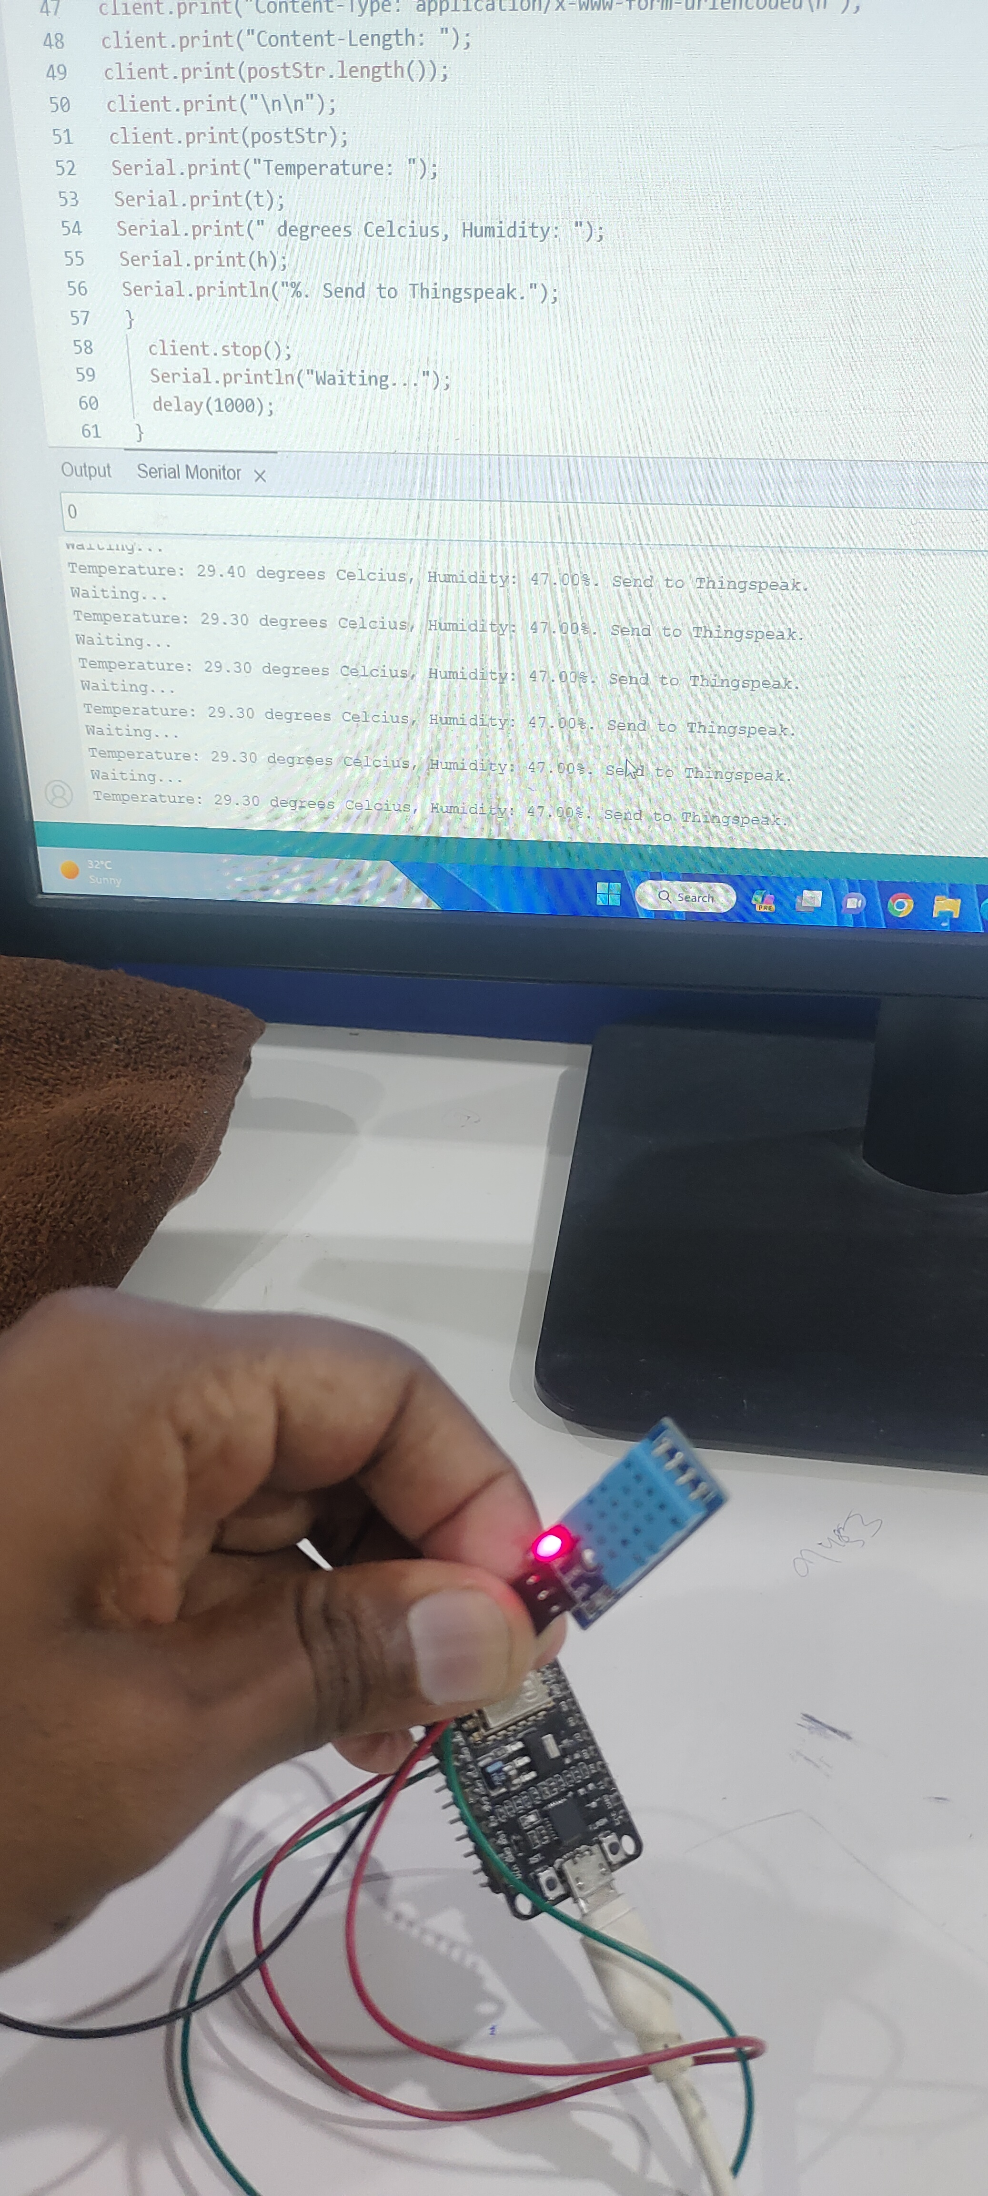
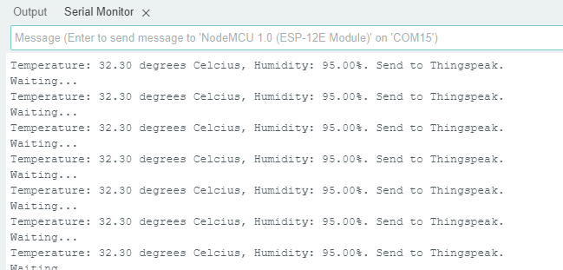
Ass. Prof. Kunal D Gaikwad
CSE Department, CMRIT

